Slide 1

Capital marketing
amcat
Prepared By:-
Priyanshu Sinha
Aseem Bastia
Sumit Das
Anish Shanbhogue
Rohith Belwadkar
Mentored by:-
Srikar Muppidi.

Slide 2
PROBLEM STATEMENT
We are trying to utilize the dataset containing information about a set of engineering graduates and their employment outcomes to analyse the following few use cases –
Given a new student profile, can we predict his/her annual salary from historic data?
Can we understand what factors in the labour market determine one’s salary?
Ans:-
Is it just one’s skills or there are other factors which influence the return in the labour market?
What signals and biases enter the labour market?

Slide 3
EXPLANATION OF THE DATASET
The entire data is collected from Aspiring Minds' Employment Outcomes 2015. The dataset contains various information about a set of engineering candidates and their employment outcomes. For every candidate, the data contains both the profile information along with their employment outcome information. Candidate Profile Information includes:
Scores on Aspiring Minds’ AMCAT – a standardized test of job skills. The test includes cognitive, domain and personality assessments
• Personal information like gender, date of birth, etc.
• Pre-university information like high school grades, high school location
• University information like GPA, college major, college reputation proxy.
• Demographic information like location of college, candidates’ permanent location
Employment Outcome Information includes:
• First job annual salary
• First job title
• First job location
Random AMCAT takers were surveyed via email wherein they provided information on the dependent variables in this dataset – the jobs they are in and their corresponding annual salaries. Corresponding independent information about the candidates was recorded at the time of them taking AMCAT.

Slide 4
FEATURE EXPLANATION
Variable | Description
ID | AMCAT ID
Salary | Annual Salary of AMCAT Students
DOJ | Date of Joining the job
DOL | Date of Leaving the job
Designation | Job profile of the candidates
JobCity | City where the candidates secured job
Gender | Gender
DOB | Date of Birth
Age | Age of candidates
10percentage | Percentage of candidates in 10th
10board | Board of education (High School)
12graduation | Percentage of candidates in 12th
Variable | Description
12board | Board of education (12)
CollegeTier | Status of college
CollegeID | College ID
Degree | Degree pursued by candidate
Specialization | Specialization in degree
collegeGPA | GPA of candidates in Degree
CollegeCityID | ID of the college
CollegeState | State where the college is situated
CollegeCityTier | Status of city
GraduationYear | Year when the candidates graduated
English | AMCAT Score in English
Logical | AMCAT Score in Logical
Variable | Description
Quant | AMCAT Score in Quant
Domain | AMCAT Domain Percentile
ComputerProgramming | AMCAT Score in Computer Programming
ElectronicsAndSemicon | AMCAT Score in Electronics and Semiconductor
ComputerScience | AMCAT Score in Computer Science
MechanicalEngg | AMCAT Score in Mechanical Engineering
ElectricalEngg | AMCAT Score in Electrical Engineering
TelecomEngg | AMCAT Score in Telecom Engineering
CivilEngg | AMCAT Score in Civil Engineering
conscientiousness | Personality traits
agreeableness | Personality traits
extraversion | Personality traits
nueroticism | Personality traits

Slide 5
DATA CLEANING
Graduation CGPA column has multiple data types like some students entered percentage and some have entered CGPA.
Domain marks contains negative(-1) for those students who didn’t opt for the particular subject and some of the students have opted multiple subjects.
The 10th and 12th board columns contains multiple board names, school names and school addresses.
Data distributions of various variables are highly skewed and have to apply some transformation before passing it to model.
JobCity Column:
• City’s were named differently like Bangalore, Bengaluru so we have changed them into a single City for better EDA.
• There were many spelling mistakes, spaces and upper and lower cases in the city names.
• To get it rectified, we have used Regular Expression using Python.
10th Board and 12th Board Column:
• There were many different types of state boards in our dataset.
• Few of them have made spelling mistakes, short form of their boards and few of them have not mentioned their boards.
• We have divided these boards as CBSE, ICSE, State Board and Unknown.
• To divide these boards we have used Regular Expression using Python.

Slide 6
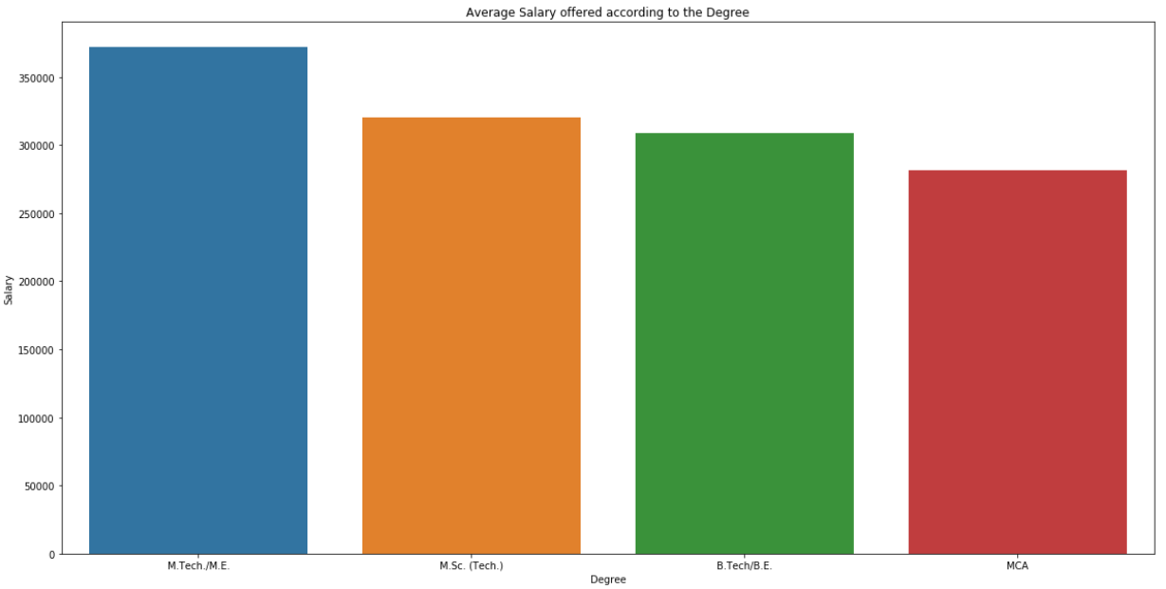
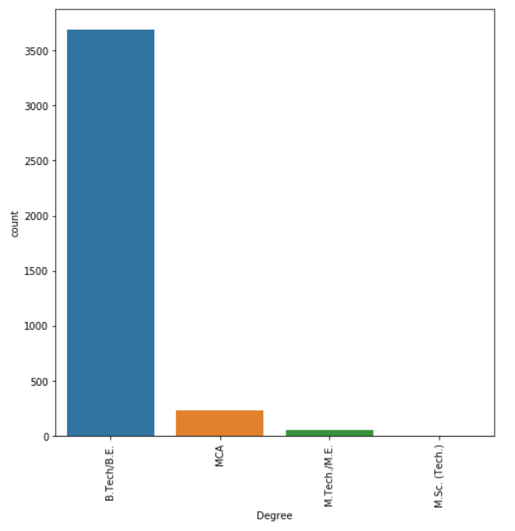
Salary Based On Degree
EXPLORATORY DATA ANALYSIS
The Below graph states that the students from M.Tech are most probably to get more average package than other degree students.
Mean salaries from M.Sc students are less since the count of students are very less.
B.Tech Students are more in count but still the average package is better than MCA students.

Slide 7
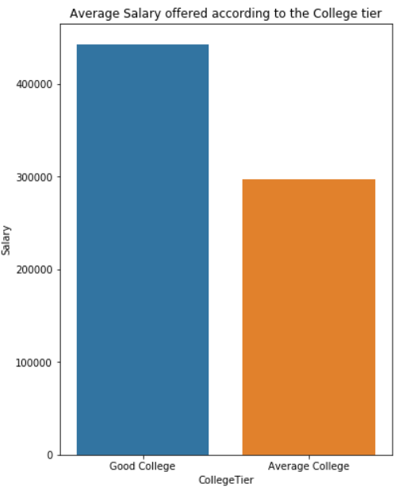
Salary based on College Tier
The Below graph states that if the student belongs to the Good college then they have received an average package more than Average college.
This inference will be used for feature selection for this particular feature since we can find a clear trend.

Slide 8
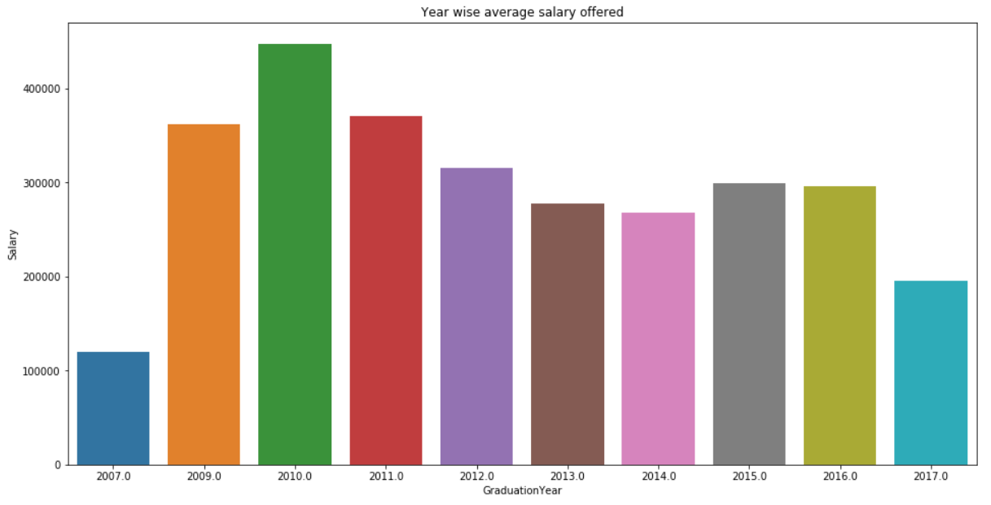
Salary based on Graduation Year
The Below graph states that the students those who have graduated in 2010 have got better average package as compared to the other year of graduation.

Slide 9
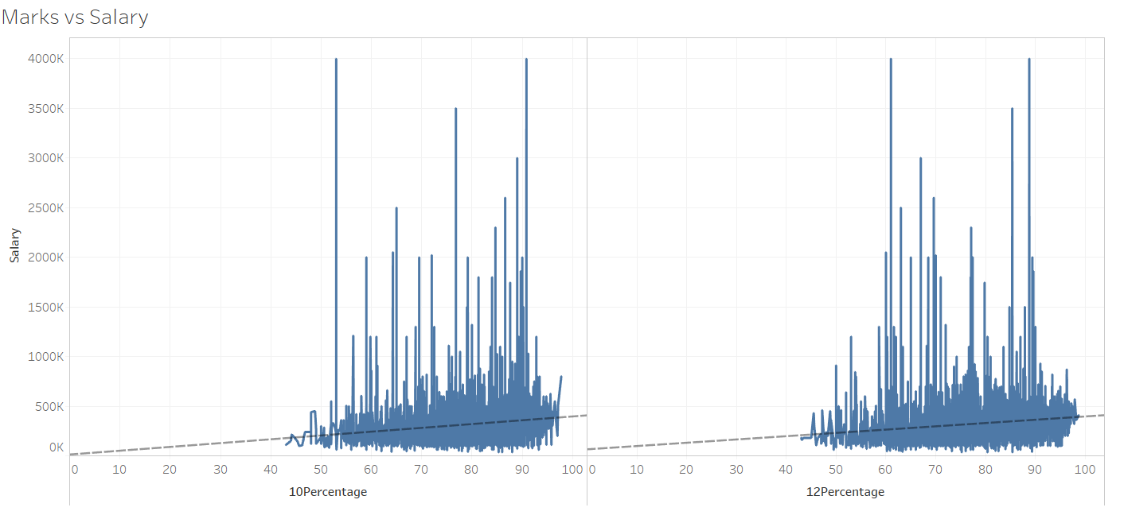
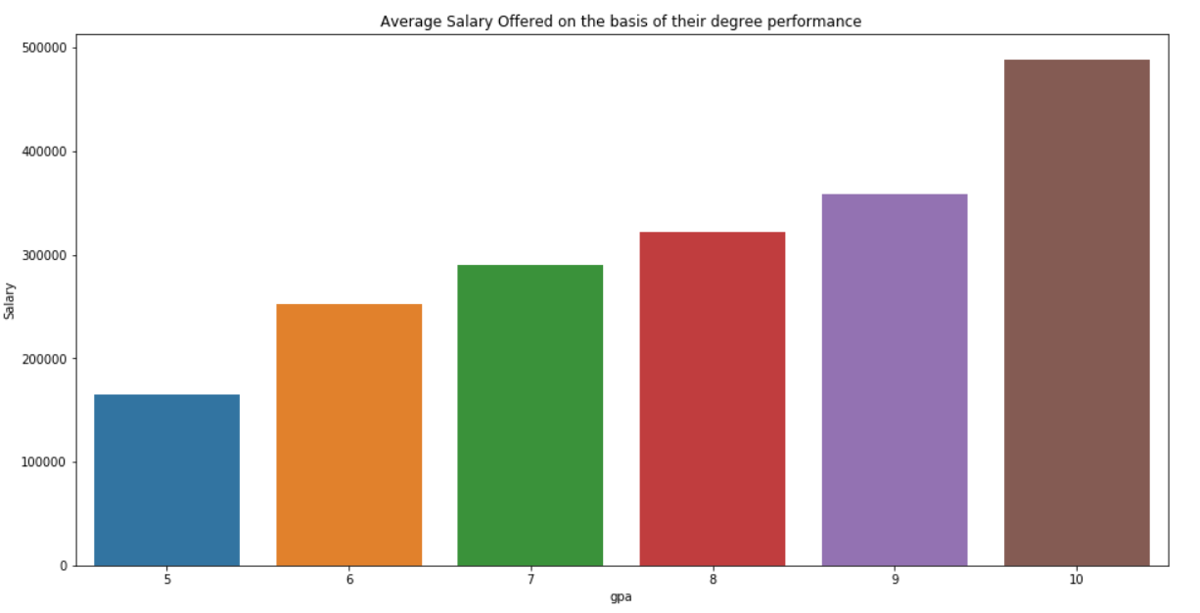
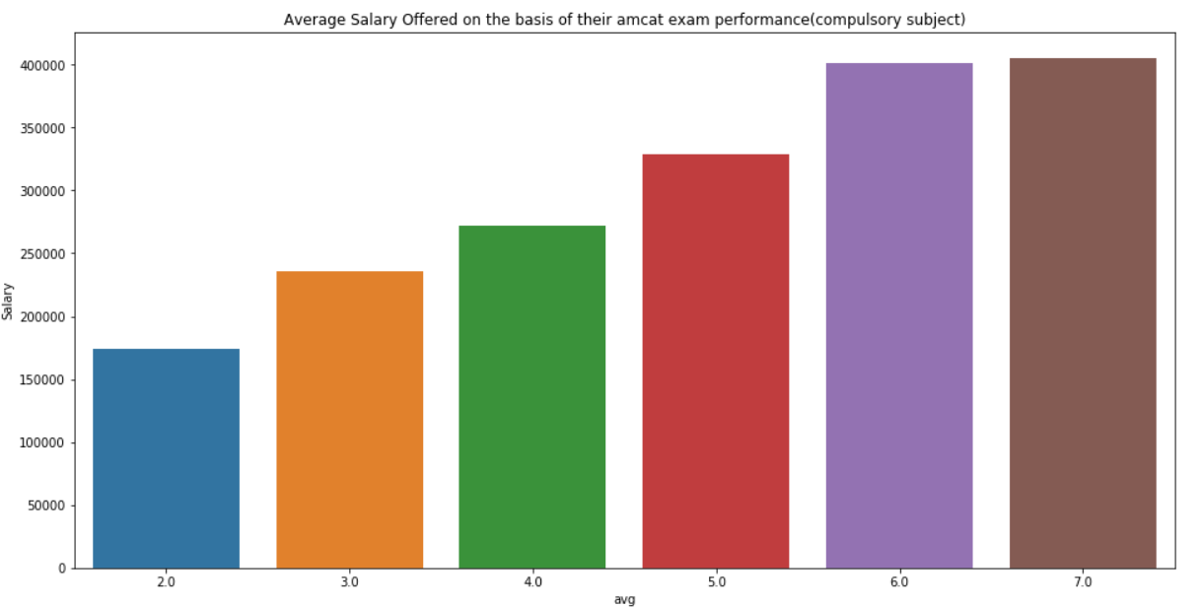
Salary Based On Marks And Performance In Academics
The Below three graph states that if a student gets good marks in his 10th, 12th, College CGPA or AMCAT marks then it is likely to get good salary.
This trend of marks are directly proportional to the salary.

Slide 10
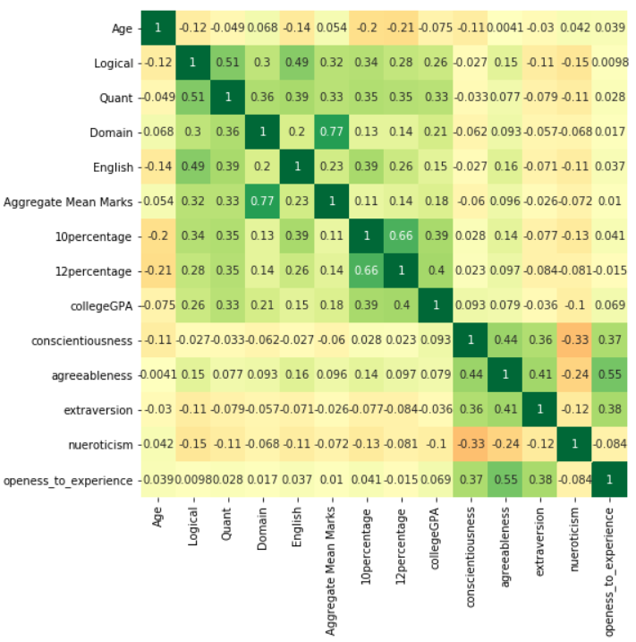
Correlation Plot
This is the correlation plot between the variables after applying data cleaning. This are all continuous features from the dataset. The correlation matrix for all continuous variable the shows that many features are multi-collinear with each other. So we must fix this by using VIF(Variance Inflation Factor) or PCA(Principle component analysis).

Slide 11
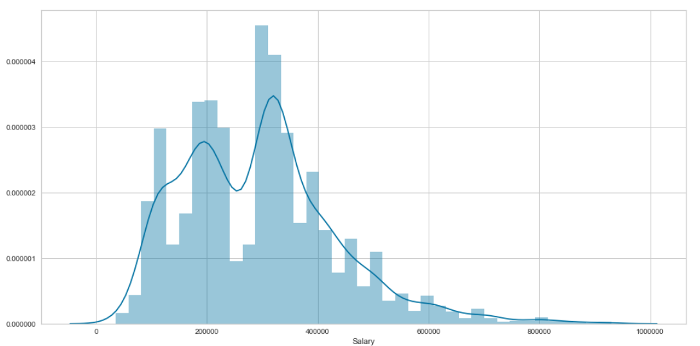
PREPARATION FOR REGRESSION MODEL
The Data preparation process are as follows:-
• After data cleaning and EDA we have exported a cleaned data and we will use the same for further model building.
• After importing the data we have removed all the outliers using Z-score.
• We chose those z-score values which are in the range of -3 to 3.
• Now we will drop few unnecessary features. Those are as follows:-
• Next we will factorize the categorical values using LabelEncoder()
Variables | Reason to Drop the Variables
ID | ID is Unique value.
DOJ | It is a dependent variable
DOL | It is a dependent variable
Designation | It is a dependent variable
JobCity | It is a dependent variable
DOB | Instead of using DOB we will use Age
College ID | It is unique value
College City ID | It is unique value
College City Tier | Not getting a proper inference from it
ComputerProgramming | Contains many null values
ElectronicsAndSemicon | Contains many null values
ComputerScience | Contains many null values
MechanicalEngg | Contains many null values
ElectricalEngg | Contains many null values
TelecomEngg | Contains many null values
CivilEngg | Contains many null values
After removing the outliers the salary distribution is normalized

Slide 12
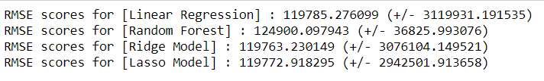

REGRESSION MODEL
• Modelling using the listed algorithms was done under multiple scenarios and results compiled for overview.
• For Hyper parameter tuning, we have used Grid-Search CV.
• The List of tuned models with the RMSE Scores and variance are as follows:-
• The Above RMSE’s is very high with the very less accuracy of each model.
• This is because of lack of sufficient data in our dataset. So our model is not able to predict the salary.
• So that’s why we must go with multiclass problem since it is possible to provide a range of salary.

Slide 13


PREPARATION FOR CLASSIFICATION MODEL
• The data preparation for Classification model is similar to regression model but here we have made some changes on features.
• We will classify the salary into three types i.e. High Package(greater than 6 lpa, 0), Medium Package(between 3.5 and 6 lpa, 2) and Low Package(less than 3 lpa, 1).
• Our Data is highly imbalanced and the count of multi classes are as follows:-
• So the count of Student who has got less package is more so our model may not predict High and Medium Package
• To remove imbalance in our dataset we have used SMOTE-NC in python
• SMOTE-NC basically stands for Synthetic Minority Over-sampling Technique for Nominal and Continuous . This is a statistical technique for increasing the number of cases in the dataset in a balanced way. The module works by generating new instances from existing minority cases that we supply as input. This implementation of SMOTE-NC does not change the number of majority cases.
• After Using SMOTE, the dataset is balanced.
• According to our correlation matrix, we have a lot of multi collinearity in our dataset. Since we cannot remove few features due to lack of important continuous features.
• So we will use PCA(Principle Component Analysis) in Continuous features only.
• We have used 12 principle components with explained variance ratio of 96% .
• We will merge 12 Principle components with the remaining categorical features followed by dropping all continuous features

Slide 14
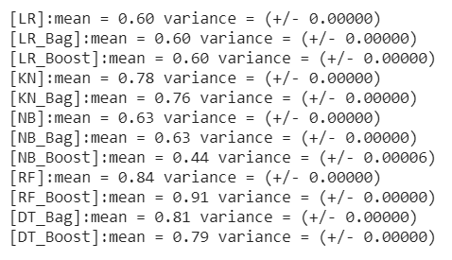
CLASSIFICATION MODEL
• While building Classification model, we have used the above model features with dependent Multi-class Salary.
• For Hyper parameter tuning, we have used Grid-Search CV.
• The List of tuned models with the Mean F1 Scores and variance are as follows:-
• From the above different models Random Forest Ada-Boost model is performing very well with proper hyper-parameter tuning. So we will use the same as our main Algorithm.
• Hyper parameters used : n_estimators(RF)= 21 , n_estimators(Ada) = 81

Slide 15
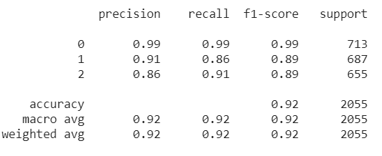
ADA-BOOST RANDOM FOREST ALGORITHM PERFORMANCE
• Below is the Precision, Recall and F1-Score of the AdA-Boost Random Forest Algorithm
• We will check multiclass performance using F1-Score.
• The Above confusion matrix and Precision score for High Package is very high, this basically states that our model will predict High Package precisely. So It may reduce false promising data.
• This model may vary while predicting the Low Package.
• For predicting medium Package our model is struggling more but Still the F1-Score is similar to the Low Package.
 |  | Actual
Predicted | High Package | 706 | 0 | 7
 | Low Package | 3 | 594 | 90
 | Medium Package | 2 | 56 | 597

Slide 16
THANK YOU

